Slide 1
Welcome to the Quarterly Grants Management Symposium
Hosted by the National Academy of Public Administration & Grant Thornton LLP
July 12, 2019

Slide 2
Agenda
Start Time | End Time | Topic | Attendees
8:45 AM | 9:15 AM | Networking Breakfast
9:15 AM | 9:20 AM | Welcome and Opening Remarks | Wendy Morton-Huddleston, Principal, Grant Thornton
9:20 AM | 9:30AM | Updates on the President’s Management Agenda Framing for today’s discussion | OMB Kathy Stack
9:30 AM | 9:45 AM | Current HHS-led Initiatives to engage state and local officials on strategies for improving economic mobility outcomes Reimagine HHS’ Aim for Independence Initiative | Mishaela Duran, Director, ACF Office of Regional Operations
9:45 AM | 10:20 AM | State and local perspectives on: Grants Management barriers to improving economic mobility Potential strategies to address them | Duke Storen, Commissioner, VA Department of Human Services Nannette Bowler, Director, Fairfax County Department of Family Services
10:20 AM | 11:00 AM | Discussion

Slide 3
National Academy of Public Administration: Who We Are
An independent, non-profit, and non-partisan organization assisting government leaders in building efficient, accountable, and transparent organizations.
Diverse practice areas include:
Organizational Assessment and Design
Strategy Development and Implementation
Program Evaluation and Performance Measurement
Business Process Transformation
Change Management
Stakeholder Outreach and Collaboration.
For more information on NAPA visit www.napawash.org

Slide 4
Grants Management Symposium Overview
Objective
Collaborative discussion to foster knowledge sharing and problem solving of critical issues in the grants management community.
Benefits
Government to government exchange of best practices and lessons learned to address common challenges;
Access to broad audience of subject matter experts & thought leaders from NAPA, public and private sectors, policymakers, nonpartisan non-profit State & Local organizations (i.e. the Big Seven), and OMB.
A forum to influence and promote change, develop new methodologies and best practices, reduce inefficiencies, enhance grant outputs and improve Government ROI on financial assistance awards.
Outcome
Tangible artifacts that can be implemented (i.e. whitepaper shared on OMB MAX.gov)
Frequency & Location
Quarterly 2-hour sessions located at the National Academy of Public Administration's headquarters, 1600 K Street, NW, Washington DC

Slide 5
2018 – 2019 Recap & Looking Forward
Highlights Four sessions held in 2018 – 2019. More than 120 attendees in inaugural year from agencies as well as stakeholders/recipients. Speakers included: Federal: OMB, HHS, GAO, NSF, ED, DOI etc. State & Local: Allegheny County Department of Human Services Industry: UPMC Health Plan, Mission Measurement, American Public Human Services Association (APHSA) etc. | Accomplishments: Engaged Office of Management and Budget's President's Management Agenda (PMA) Cross Agency Priority Goals: OMB shared perspective PMA CAP Goal 8 Results-oriented accountability for grants, OMB M-18-24, Strategies to reduce grant recipient etc. to gain agency & stakeholder input. Allowed critical engagement & dialogue between Federal Agencies and recipients: Representatives from Allegheny County DHS, UPMC Health Plan, APHSA provided their perspective & challenges with demonstrating accountability for their grants programs at the State & Local Level.
OMB Takeaways Utilize CAP goal 8 & NAPA cohort collaboration to: Develop strategy to engage this stakeholder community, Gain more input on the grants skills gap in the community, and Establish data standards for grants. | 2019 – 2020: Planned Actions/Outcomes Develop tangible & implementable artifacts (i.e. whitepapers, visualization tools, shared knowledge repository etc.). Establish Special Interest Groups (SIG) that focus on: Thought Leadership Explore Grants automation (robotics, AI and blockchain) Develop Grants Management Playbook Utilize NAPA cohort relationships to engage Congressional Decision makers & Staff via to drive grants policy making.

Slide 6
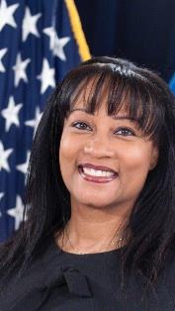
Co-Chairperson Andrea Brandon, Deputy Assistant Secretary, Deputy Assistant Secretary Budget, Finance, Grants and Acquisition Department of the Interior

Slide 7
Co-Chairperson Dale Bell, Division Director NSF Division of Institution & Awards Support

Slide 8
Mishaela Duran, Director, Administration for Children and Families Office of Regional Operations

Slide 9
NAPA Quarterly Grants Management Symposium
ReImagine HHS Aim for Independence Initiative
Putting Families in the Center: State and County Data and Recommendations to Promote Family Economic Mobility
July 12, 2019
Mishaela Duran, HHS-ACF

Slide 10
DESIGN ARTIFACTS & METHODOLOGY | PARENT PERSONAS
Discovery Approach
Human-Centered Design drives towards solutions. HCD is an approach used by business, government and social impact sectors that draws from the practices of ethnography, cognitive psychology, and the design professions to understand users’ experiences with a product or service.
Traditional approaches look at problems from the perspective of how to achieve organizational goals and priorities.
Human-Centered design looks at problems by first developing a deep understanding of users and designing services to that.

Slide 11
Setting the Stage
CURRENT STATE ASSESSMENT
Shifting Our Focus: The User Perspective
The Aim for Independence (AFI) initiative has conducted extensive research to understand the customers of the public assistance programs, including: 1) families who interact with the system; and 2) the State and County commissioners who administer it. Here is sample of Federal, State, and user perspectives when administering and using public assistance programs.
3
1
2
“I’m training to be a bus driver, host, cleaner, event space helper. My hours are all over the place. By the time I get home, I still have to get my kids, clean, and make dinner. I’m tired all the time.”
“How can we better coordinate across programs and use different access points?”
“We wish we could measure Longitudinal data – what happens to families after they leave us? Are they any better off?”
“The Federal government should measure reduction of poverty and family well-being. We don’t know where to go to see how we are doing.”
“How can we change the way the Federal level perceives the customers we serve?”
“Head Start is comprehensive - health, mental health, food, etc. Can we leverage lessons learned and best practices from our own program?”
“I’ve been in your office the last two weeks and you all have all told me you cannot help me and my daughters because your grants are written specifically for single mothers.”
“ We are trying to solve complex social problems with antiquated programs that have not changed for 20 years”
Sources: 1: Parent Interviews (24 parents across 2 regions); 2: AFI-ACF Regional Listening Sessions (7 sessions held across all regions); 3: AFI Design Session (Attended by 15+ Federal Partners)

Slide 12
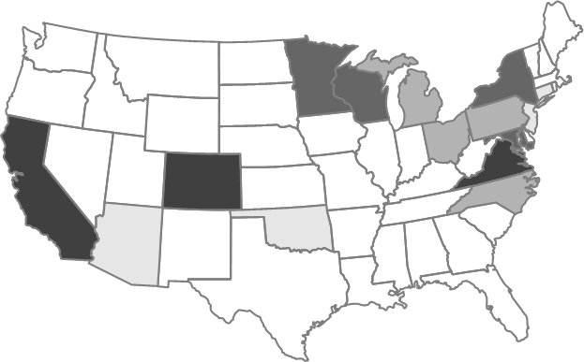
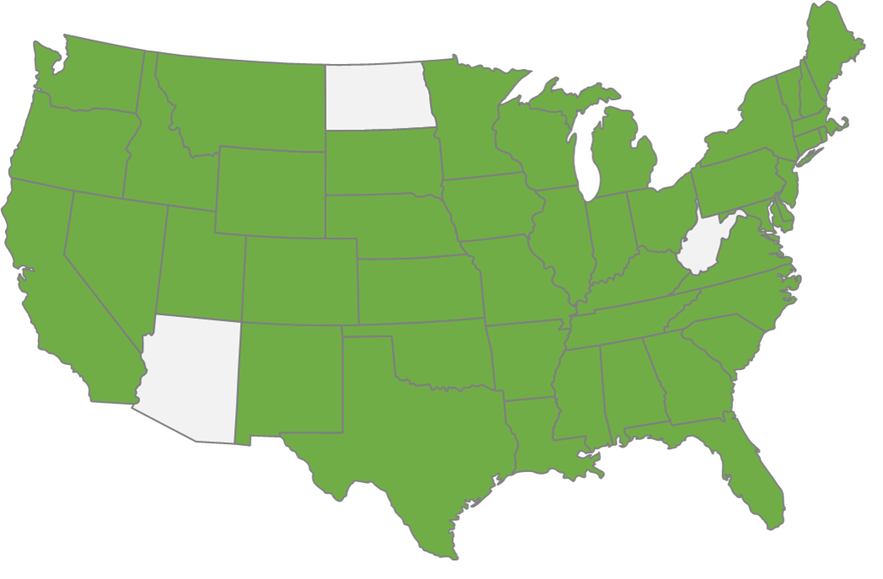
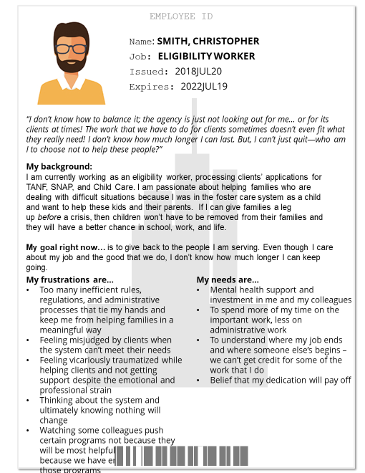
RESEARCH
WITH USERS
State and County Data Summary
AFI conducted listening sessions, surveys, and individual interviews of state and county stakeholders to identify pain points, organizational priorities, and opportunities.
HUMAN SERVICES COMMISSIONER SURVEY
COUNTY SURVEY
STATE SURVEY
66
15
55
94%
Response
Rate
County
Responses
States Represented
State
Responses
Survey Outputs:
Top Challenges Administering ACF Programs | Organizational Priorities Related to AFI | ACF Interagency Partnership Priorities
AFI-ACF REGIONAL LISTENING SESSIONS
INTERVIEWS
8
4000+
Qualitative data points gathered
6
Sessions
State Commissioners
“The Federal government should measure reduction of poverty and family well-being. We don’t know where to go to see how we are doing.”
2
County Reps
“We wish we could measure Longitudinal data – what happens to families after they leave us? Are they any better off?”
2
Program Staff
“ We are trying to solve complex social problems with antiquated programs that have not changed for 20 years”
3
State Personas Identified

Slide 14
Recommendations for Putting Families in the Center
1. Measure Outcomes, Not Just Outputs and Throughput
2. Integrate Programs to Serve Families More Holistically through Streamlining Eligibility and Interagency Collaboration
3. Prioritize People Instead of Programs
4. Standardize Data Acquisition and Management

Slide 16
Top State and County Organizational Priorities
(Scale = 1 to 100)
Organizational Priority
State Averages (n=50)
County Averages (n=65)
Focusing on Outcomes & Results
92
79
#1 Priority
#3 Priority
Improving Family Economic & Social Well-Being
83
85
#2 Priority
#1 Priority
9

Slide 17
Outcomes & Results
Parent Outcomes
Earnings and outcomes measures of interest included:
Earnings that can sustain a family and reduce dependency
Opportunities for career advancement
Job preparedness measures (skills acquisition, executive function, credentials)
Measurements and incentives for educational attainment, including high school diploma status, post-secondary and graduate degrees, and certificates.
Jurisdictions recommended measuring employment and earnings after families’ cases closed (at minimum 1-2 years after case closure to 5 years after case closure.

Slide 18
Focusing on Outcomes & Results
Child Outcomes
Child educational measures included Kindergarten readiness, school attendance, grade level progression, 3rd grade reading level attainment, high school diploma completion, post-secondary degree completion, other certificate completions, and employment.
Child health outcomes included items such as access to child care, reducing pre-term births and improved child safety.
Child outcomes included many aspects of health, educational attainment, and reactive/proactive family investments.

Slide 19
Outcomes and Results
Holistic and Longitudinal Outcomes
Intergenerational poverty, the share of welfare households that received welfare as a child, and decreases in use of public assistance as adults were also deemed as relevant longitudinal outcomes to track.
Create a self-sufficiency index (potentially standardized across agencies) that reflects state and local needs including sustainable wage earning, access to child care, health care, transportation, education, and upward financial mobility. WA, NV, and MN counties have examples that may be worth considering .
Create family wellness (financial, educational, health, social, mental health) milestones and metrics instead of hours (of work) or arbitrary counts which are not necessarily related to exiting poverty or improving family wellness.
9

Slide 20
STATE HUMAN SERVICES AGENCY RECOMMENDATIONS
Integrating Programs and Prioritizing People through Interagency Collaboration and Streamlined Eligibility and Enrollment

Slide 21
Top Two Challenges - Administering Federal Programs % Indicating the Item is a “Major Challenge”
Challenges Faced in Effectively Serving
Children and Families
State Survey
(n=50)
County Survey
(n=64)
#1 - Insufficient Collaboration Across Federal Agencies Serving Similar Populations
54%
63%
#2 - Variation in Federal Eligibility Requirements Across Programs
52%
44%

Slide 22
Priorities for Federal Interagency Partnerships % Ranking HHS-CMS (Medicaid) in the Top 3
86%
66%
State Survey
(n=50)
County Survey
(n=55)

Slide 23
Priorities for Federal Interagency Partnerships % Ranking USDA-FNS (SNAP) in the Top 3
52%
36%
State Survey
(n=50)
County Survey
(n=55)

Slide 24
Priorities for Federal Interagency Partnerships % Ranking DOL (WIOA) in the Top 3
38%
29%
State Survey
(n=50)
County Survey
(n=55)

Slide 25
Recommendations for Interagency Collaboration

Slide 26
STATE HUMAN SERVICES AGENCY RECOMMENDATIONS
DATA INTEROPERABILITY

Slide 27
Data Interoperability
(Scale = 1 to 100)
Organizational Priority
State Averages (n=50)
County Averages (n=65)
Improving Agency Performance Management Systems
82
71
#4 Priority
#7 Priority
Improving Data
Systems’ Interoperability
82
71
#5 Priority
#8 Priority

Slide 28
Data Challenges - Administering ACF Programs % Indicating the Item is a “Major Challenge”
Challenges Faced in Effectively Serving
Children and Families
State Survey
(n=50)
County Survey
(n=64)
Guidance on Privacy / Confidentiality Requirements for Sharing Administrative Data
36%
42%
Sufficient Technical Resources to Use Data to Meet Program Objectives
36%
42%

Slide 29
Ability to Align Data/Data Systems

Slide 30
Recommendations for Federal Agencies
Use of standardized data use agreements and waivers which are applicable across multiple programs and platforms rather than only a limited number of programs or platforms.
Synthesis of guidelines on legally appropriate and departmentally approved methods for conducting data sharing across departments, agencies, public, and private groups.
Unification of data sharing regulations across Departments (e.g. CMS, ACF, USDA-FNS, ED).
Alignment of data and reporting requirements across departments avoid duplication of reporting effort and reduction of administrative burden.

Slide 31
Recommendations for Federal Agencies
Large (national) data systems which address specific use cases and challenges identified by clients and stakeholders, tailored to federal requirements and regulations, which states and partners can utilize (e.g. data clearinghouses, software packages, or database solutions).
Federal funding for data interoperability like the 90/10 funding and A-87 waiver opportunity provided by CMS and OMB.
Data element “dictionaries” including sharing eligibility or use agreements, and broad crosswalks across multiple data systems.

Slide 33
Duke Storen Commissioner, Virginia Department of Human Services

Slide 34
National Academy of Public Administration
Quarterly Grants Management Symposium
July 12, 2019

Slide 35
Social Services System Overview
State Supervised/Locally Administered
120 local departments with 9,000 employees
Child Welfare – CPS, Foster Care, Family Preservation
SNAP, TANF, Child Care, Energy Assistance, Medicaid
Workforce Services (SNAP, TANF, Maybe Medicaid, some WIOA)
Local programs
31 Community Action Agencies (Head Start, CSBG)
State Administered Services
IV-D -- Child Support Enforcement – 18 offices
CCDF -- Licensing – 7,000 facilities statewide and growing
CAPTA - CPS/APS Hotline, EITC Outreach, Financial Literacy
1650 employees State Employees

Slide 36
What Works? – Service Delivery
Early Childhood Investments
Focus on Social Determinants (primary prevention)
Whole Family Approach
Customer Centric – Customer Driven

Slide 37
Challenges
Federal grants/programs are focused on solving specific problems, but many families have multiple needs.
Significant restrictions on funding social determinants/primary prevention.
Need help funding two most important drivers of success – people and technology
Time – spend time on value added

Slide 38
Focus on Shared Services
What services are shared?
Intake – multiple channels (call center, on-line, in-person)
Assessment
Case Management
Data analytics (what works?)
What management functions and expenses are shared?
Technology support for services
Data management and analytics
Back office functions
Leadership

Slide 39
Lessons Learned
Social Services Block Grant
-- Focused Purpose
-- Flexible Funding
-- Transfer Funds from existing federal grants into SSBG
A87 Waiver
-- financial incentive for integration
-- streamline process planning, implementing, financing, and reporting systems development with federal government
Cost Allocation Plans (HHS-USDA)
-- effective to share staff/services across programs
-- Often costly and time consuming

Slide 40
Ideas for Consideration – current grants framework
Increase administrative cap on grants
Consistency on what included in administration costs
Make staff training, data management, analytics, technology, evaluation allowable program costs (varies by grant today)
Grants require indirect cost rates, even if an agency has an approved Cost Allocation Plan
Raise the dollar threshold for the APD Process
Help develop model cost allocation methodologies for core shared services (add DOL to HHS-USDA partnership)
Bring back some version of A87

Slide 41
New approaches based on lessons learned
Create technology financing vehicle (fund) and allow transfer of funds from existing federal grants
Ditto for other core shared services (intake, case management)
9. New Financing Approach for Modular IT
Discrete business functions that serve multiple programs
Develop using funds across multiple programs without federal approval as long as each programs limits investment Example: IV-D, IV-A, IV-E, CCDF, Medicaid, and SNAP all pay vendors and/or people. Allow states to build this module to be used across programs using technology products and services procured according to state procurement laws. Cap contributions from any one program at $X.

Slide 43
Nannette Bowler Director, Fairfax County Department of Family Services

Slide 44
Achieving Better Grant Management Outcomes, Fairfax County
Fairfax County steps to move funding resources toward positive outcomes:
Performance Contracting
Infant Toddler Connection
Use of a “retainage” and bonuses to ensure contractor performance. Significant change in contractor engagement in outcomes.
Data Analytics
Understanding root causes of client needs.
Builds staff analytical skills to maximize resources to improve outcomes.
Targets areas of concern and populations.

Slide 45
Achieving Better Grant Management Outcomes, Fairfax County
Common Sense steps, big gains:
Flexibility
Eliminate the formal Amendment process for moving budget between budget categories, provided the bottom line of the grant is not exceeded.
Automate
Clarify federal guidance on Time and Effort reporting to embrace the use of strong payroll systems that bill time automatically to grants.
Provide an application that facilitates the capture and spreading of costs, such as space. Let’s not continuously recreate the wheel.

Slide 46
Achieving Better Grant Management Outcomes, Fairfax County
Legitimize Strategy and Quality Efforts
Recognize strategic planning, data training and research efforts, quality review and improvement efforts as critical to grant success. Allow these costs as either a direct charge or a cost-allocated charge to a grant.
Likewise, recognize training in support of positive client interaction as an allowable grant expense.
Improve Outcome Assessment and Reporting
There is often a lack of consistency in how federal grantors request outcome data to be sliced by age, population groups, etc.
One grantor should cut population data using the same age brackets, ethnic groups, or other demographic indicators for all grants awarded. This approach would provide a stronger foundation for assessing the outcomes achieved across multiple grants and local funding.

Slide 47
Discussion

