Slide 1
Communications and Vulnerability
DeeDee Bennett, Ph.D.
Assistant Professor

Slide 2
Emergency Communications
Organizational Communications
  Within an organization
  Across multiple organizations
Public Communications
  Warnings
  Public education campaigns

Slide 3
Emergency Communications Technology
Sirens
Television
Radio
Door-to-Door
NOAA Weather Radio
Digital Signage
Web Applications
Websites
Mobile Phones
Social Media

Slide 4
Vulnerable Populations
Individuals that may have a more difficult time anticipating, responding to, or recovering from a disaster due to their ability or situation. (Wisner et al., 2004)
Nearly 50% of the US population falls into a socially vulnerable category, i.e., individuals with access and functional needs. (Kailes & Enders, 2007)
  56.7 million people with disabilities – (Brault, 2012)
  Children
  Elderly
  Low income
  Certain ethnic minorities
  Travelers
  Recent immigrants

Slide 5
What impacts Access and Credibility?
Method of dissemination
Content of the message
Type of devices used by public

Slide 6

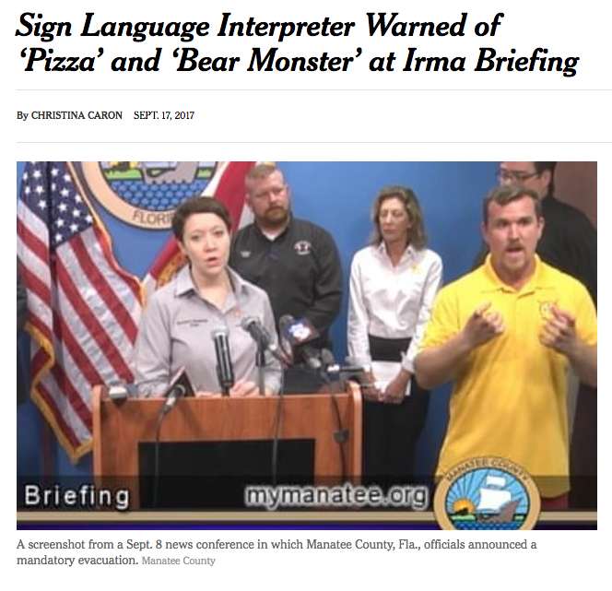

Slide 7
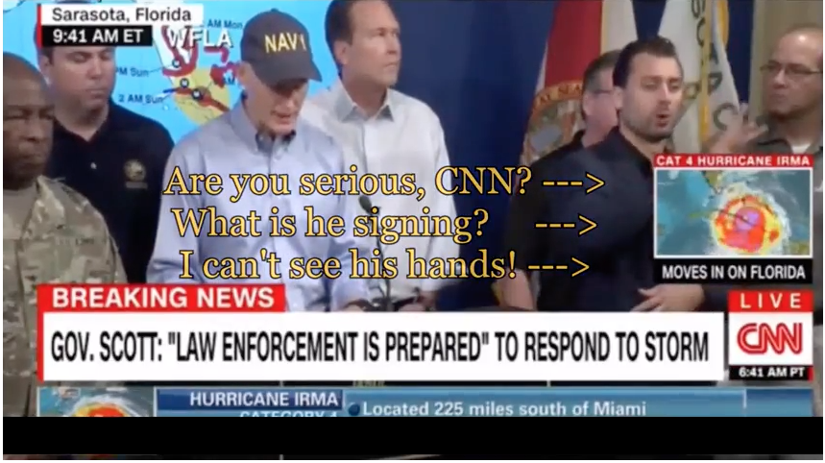

Slide 8
Impact of New Tech on The Warning Process
Method of dissemination
  Internet
  Wireless Carriers
Content
  Clarity, accuracy
  Enough information
  Language Barriers
Devices
  Mobile phones
  Tablets
  Laptops
  Desktop computers

Slide 9
Method of Dissemination (emergency Managers)

Slide 10
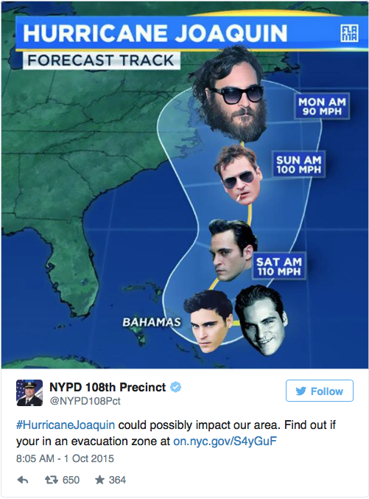
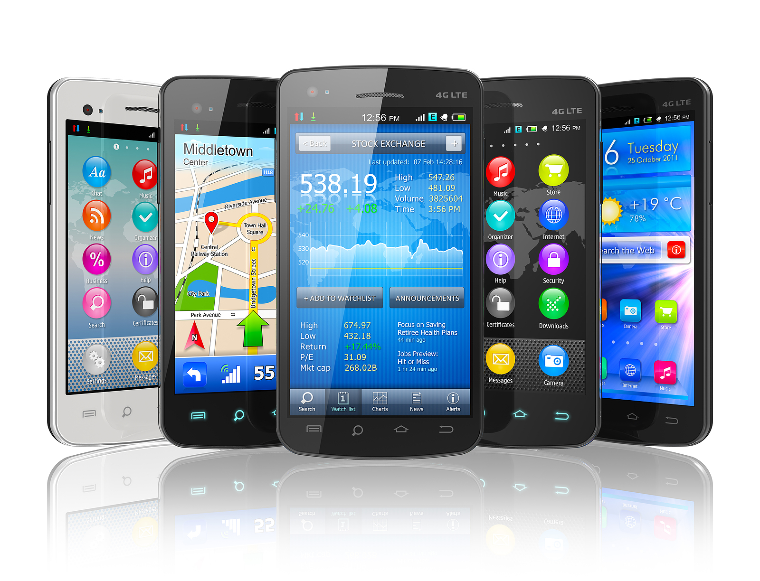

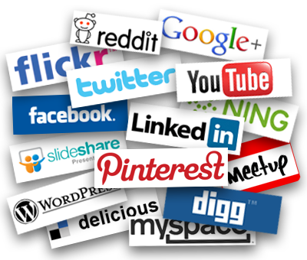
Technology and Warning Process
45% use cell phone to access social media platforms
43% live in cellphone-only households
(pew research, 2015)
65% use cell phone
to access the
Internet
(pew research, 2015)
Many social media posts link to websites

Slide 11
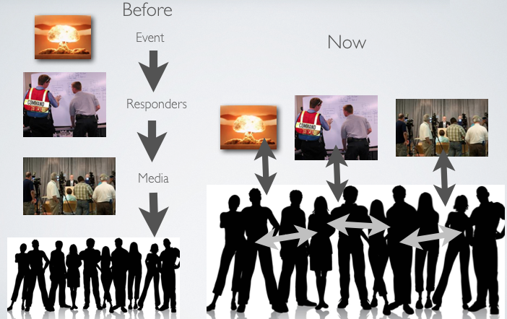
Change in Warning Process

Slide 12
Content
  Public Response
    Hear Message
    Believe Message
    Respond PROPERLY to Message (if yes, protective action)

Slide 13
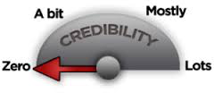
Influencing Response from Public (Mileti & Peek 2000)
Source of the information
  Credibility
  Reliable
  Who do you deem credible?
    Government official? FEMA? Scientists? University?
Message Consistency
  Inconsistent information can lead to confusion
  Inconsistent tone can lead to misunderstanding or non belief
Notes:
Source – most believed if coming from a mixed set of persons, people have different views on what is credible or not

Slide 14
Influencing Response from Public (Mileti & Peek 2000)
Accuracy
  Contents of message should include:
    Location of the risk
    Information on the risk
    What to do
Clarity
  Worded clearly
  Simple language
Notes:
Accuracy – be honest and open with the public about the hazard enhances accuracy
Certainty – If low probability or ambiguous situation should be stated with certainty

Slide 15
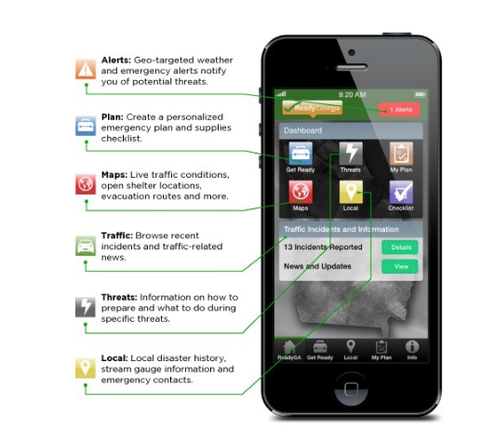
Mobile Phones
Mobile Apps
Social Media
Cell Broadcast Technology
  (Wireless Emergency Alerts)

Slide 16
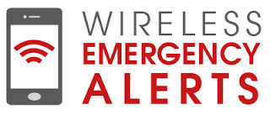
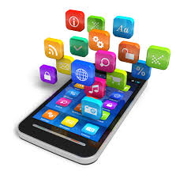
Newer Channels Used to Warn
Cell Phones
  Mobile Apps
  Subscription based messages
  Wireless Emergency Alerts
  Social Media

Slide 17
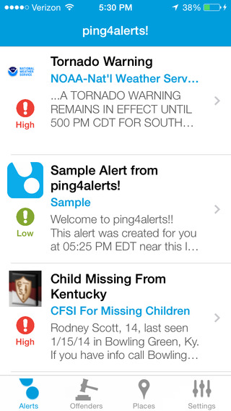
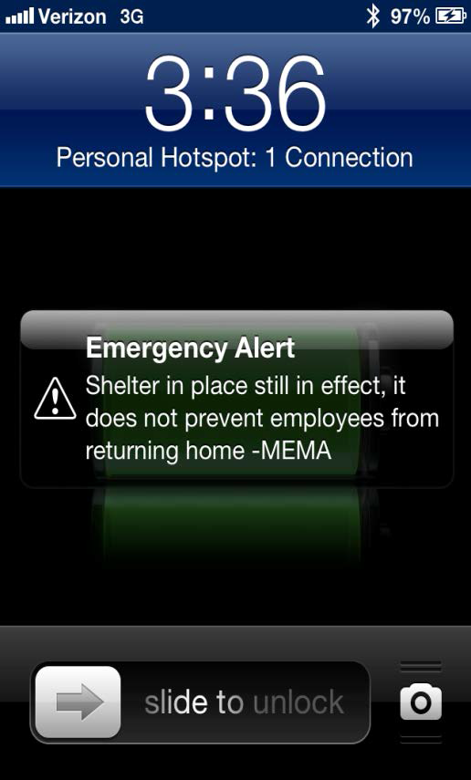
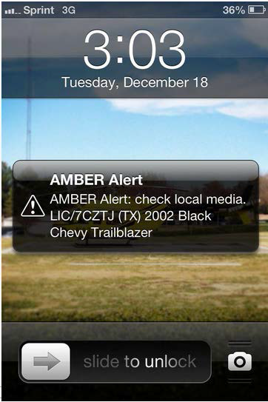
Phone Alerts

Slide 18
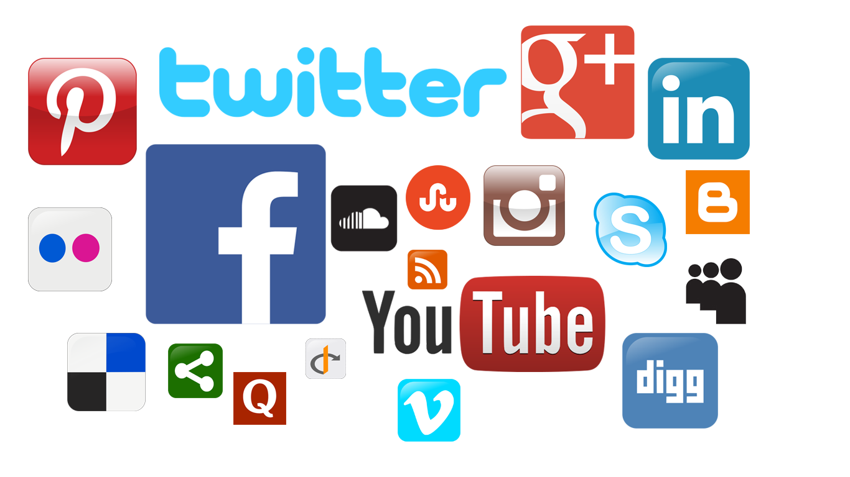
Social Media for Emergency Management (SMEM)
Used by:
  Federal, State and Local EMs
  Non-Profits
  Private Sector
Used for:
  Emergency Preparedness Information
  Public Alerts and Warnings
  Situational Awareness

Slide 19


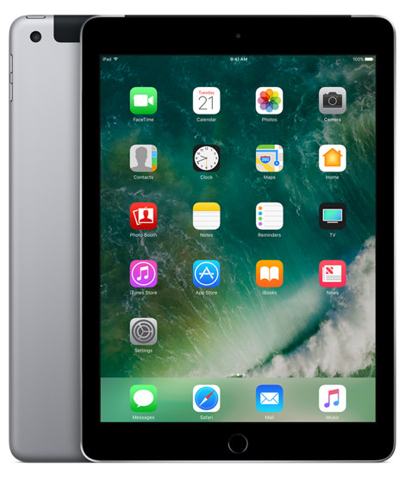

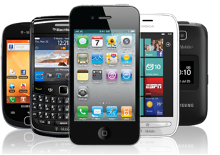

Devices

Slide 20



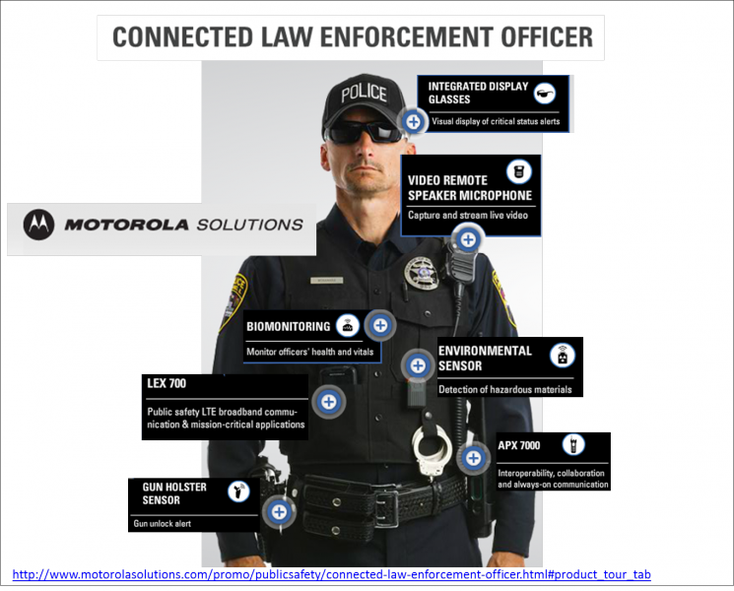
Going Forward
Practice
  Flexibility to keep up with the progression of technology
Policy
  Very few legislations incorporate explicit rules for the inclusion of people with disabilities specific to disaster situations
  Liability concerns, legal ramifications, or prohibitive policies.
Research
  Interconnectedness of mobile devices
  Wearable technology
    Provide accessible information such as braille, text, voice, or ASL interpretation
  Streaming video
    Netflix, DVR, Amazon Prime Hulu

Slide 21
References
Bennett, DeeDee and Salimah LaForce. (2018). Text-to-action: understanding the interaction between accessibility of wireless emergency alerts and behavioral response. In Understanding the Roles of Risk Communication in Community Resilience Building by (Eds.) Bandana Kar and David Cochran. Routledge. (Forthcoming)
Bennett, DeeDee. (2017). Providing Critical Emergency Communications via Social Media Platforms: Cross-Case Analysis. Routledge Handbook on Information Technology in Government by (Eds.) Yu-Che Chen and Michael Ahn. Routledge. (Accepted)
Bennett, DeeDee, Paul Baker, and Helena Mitchell. (2017). “New Media and Accessible Emergency Communications.” Chapter 9 in Disability and Social Media by (Eds.) Katie Ellis and Mike Kent. Routledge
Bennett, DeeDee, Brenda Phillips, and Elizabeth Davis. (2017). “The Future of Accessibility in Disaster Conditions: How Wireless Technologies Will Transform The Life Cycle of Emergency Management.” Futures Journal.
Bennett, DeeDee, Braden Benson, and Danielle Sharpe. (2014). “Dissemination of WEA: Survey of Alert Authorities.” Center for Advanced Communications Policy (CACP) on-line publications. Atlanta, GA. http://cacp.gatech.edu/papersreportsbriefs
Bennett, DeeDee. (March, 2015) “Gaps in Wireless Emergency Alert (WEA) Effectiveness Research Brief,” Center for Advanced Communications Policy (CACP) on-line publications. Atlanta, GA. http://cacp.gatech.edu/sites/default/files/gapsinweafinal.pdf
Brault, M.W. (2012). “Americans with Disabilities: 2010.” U.S. Census Bureau, Washington, D.C., 2012. Accessed July 23, 2014 from http://www.census.gov/prod/2012pubs/p70-131.pdf
Kailes, J. I., & Enders, A. (2007). Moving beyond “special needs” A function-based framework for emergency management and planning. Journal of Disability Policy Studies, 17(4), 230-237.
Mileti, D. and L. Peek (2000). The Social Psychology of Public Response to Warnings of a Nuclear Power Plant Accident. Journal of Hazardous Materials 75(181-194).
Pew Research Center. (2015). Mobile Technology Fact Sheet. Pew Research Internet Project. Retrieved from http://www.pewinternet.org/fact-sheets/mobile-technology-fact-sheet/9/ on April 29, 2015.
Wisner, B., P. Blaikie, T. Cannon, and I. Davis. (2004). At Risk: Natural Hazards, People’s Vulnerability and Disasters. London, Routledge.

Slide 22


Thank You!
Any Questions?
DeeDee Bennett, Ph.D.
Assistant Professor
@D_M_Bennett
dmbennett@unomaha.edu

