Slide 1
Small Business as a Vulnerable Population
Lt. Mark Landahl, PhD, CEM®
Frederick County Sheriff’s Office – Maryland
Tonya T. Neaves, PhD, MPP
Schar School of Policy and Government – George Mason University

Slide 2
The U.S. Policy Perspective: When is a Business Large or Small, or not a Business at all?
SBA uses the North American Industry Classification System (NAICS) to define small businesses in 1,141 categories and 18 sub-industry activities.
Definitions for inclusion or exclusion of a “small business” from programs has significant financial ramifications.
Small business programs exist at Federal, state and local governments levels. Each program contains differing definitional criteria for eligibility.

Slide 3
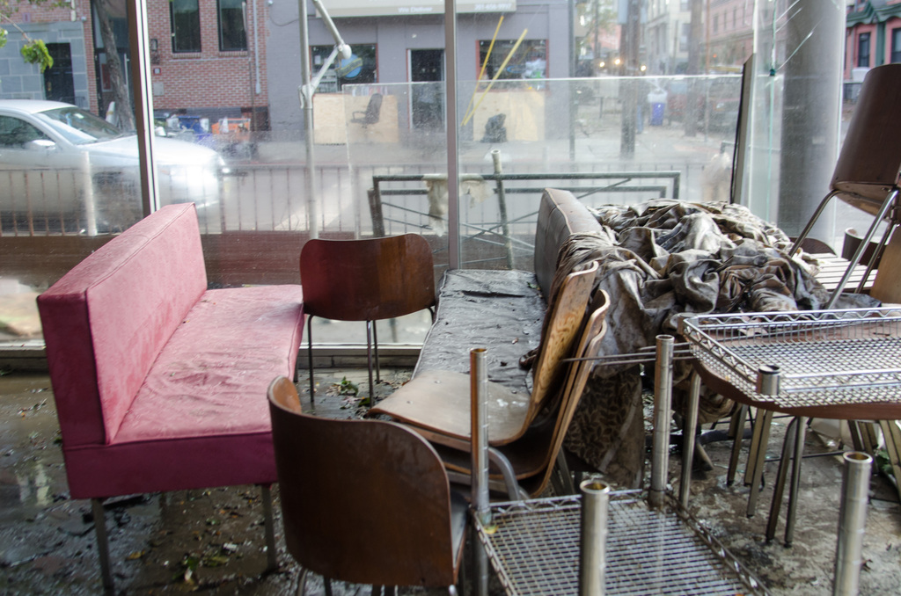
Small Business? It Depends…at the Federal Level
The SBA market analysis results in standards using five metrics: 1) number of employees, 2) average receipts (three previous years), 3) asset size, 4) barrel per day refining capacity for petroleum, and 5) megawatt hours for electric power industries.
Example:
The number of employees that defines a small business differentiates across industrial classifications.
Air Transportation Sector: Small = less than 1,500 employees.
Retail Fuels Sector firm: Small = less than 50 employees (SBA, n.d.).
FEMA Photo by Liz Roll

Slide 4
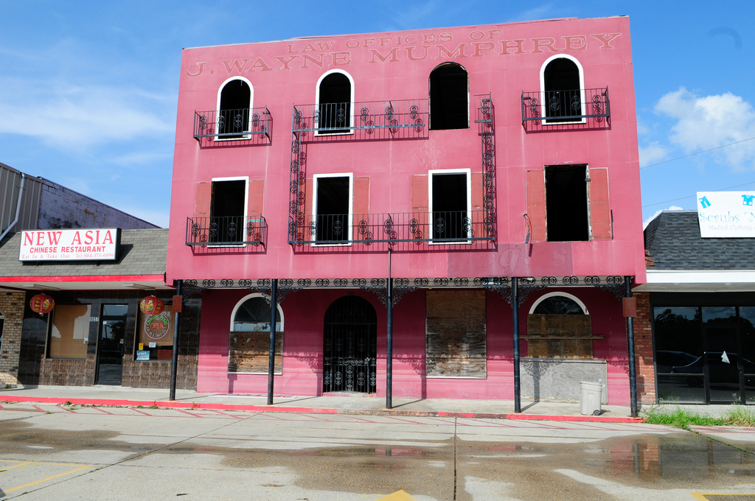
Importance of Small Business
Bureau of Labor Statistics data show that in 2014, businesses with less than 50 employees accounted for 34 percent of new job growth (BLS, 2015).
Small businesses contribute in many areas beyond job growth, often described as the “backbone” of the American economy and a cornerstone of the American dream.
All businesses are not created equal… in size, sales, or scope.
FEMA Photo by Barry Bahler

Slide 5
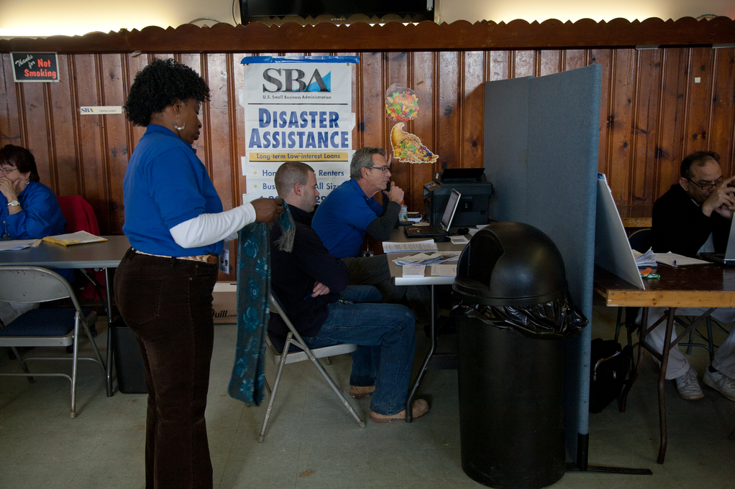
Small Business and the EM Literature
Limited studies with businesses as a unit of analysis study compared to traditional elements of society (ex. government and household).
Tierney (2006) identifies that earlier research generally focuses on impacts at the aggregate community, regional, and national levels (Friesma et al., 1979; Rossi et al., 1978; Thompson, 2009).
Research interest in the future impacts of climate change has increased attention on the topic. (Hazard Adjustment)
FEMA Photo by Ed Edahl

Slide 6
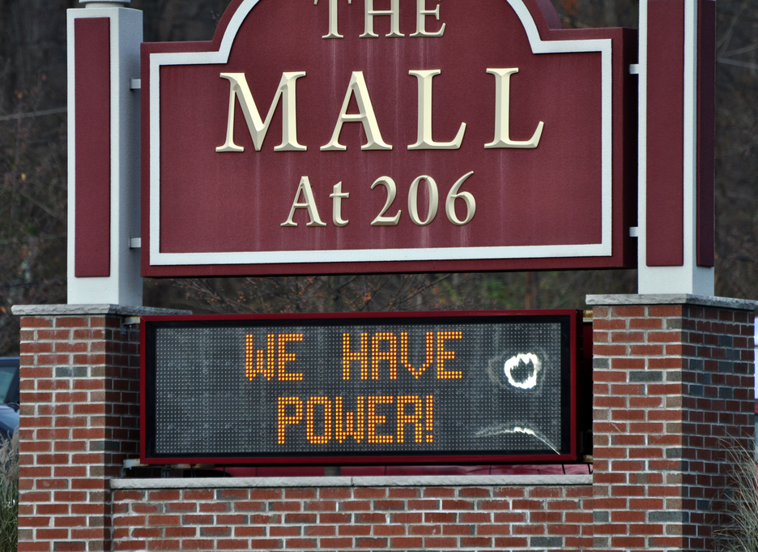
Small Business? Additional Complicating Factors
Non-employer Business: “has no paid employees, has annual business receipts of $1,000 or more ($1 or more in the construction industries), and is subject to federal income taxes” (U.S. Census Bureau, n.d.).
Ownership Demographics: 1) Minority Small Business and Capital Ownership Development Program (known as the “8(a) program”); 2) Small Disadvantaged Business program, and 3) Women-Owned Small Business Federal Contract Program, as well as the Department of Transportation Disadvantaged Business Enterprises program.
Geography: Historically Underutilized Business Zones (HUBZone)
FEMA Photo by Sharon Karr

Slide 7
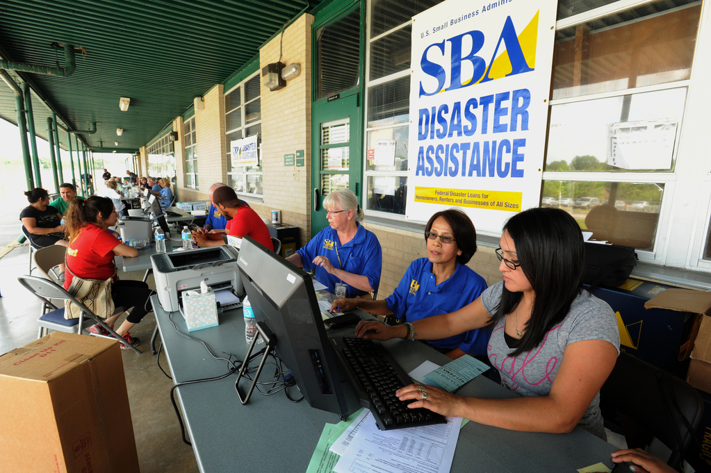
The U.S. Policy Perspective: When is a Business Large or Small, or not a Business at all?
Extreme complexity into putting two seemingly simple words: ‘small’ and ‘business’ together.
The definition of a small business is not a static concept, even in law.
The Small Business Act of 1953 empowers determine standards for defining small businesses (13-CFR-121).
The law does not provide specific standards, but directs SBA to create and maintain the standards.
FEMA Photo by Jocelyn Augustino

Slide 8
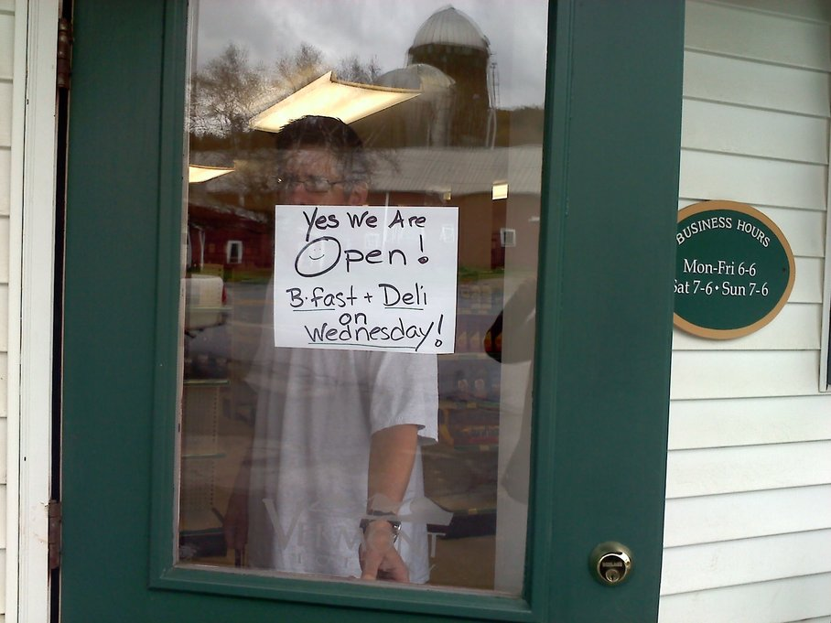
Small Business? It Depends…at the State Level
Maryland defines “Small business” a business, other than a broker, that meets the following criteria:
• Independently owned and operated;
• Not Subsidiary of another business; and
• Not dominant in its field of operation (Maryland State Finance and Procurement Code 14-501).
Sector | Number of Employees | Gross Sales (in millions)
Wholesale | Not more than 50 persons | $4
Retail | Not more than 25 persons | $3
Manufacturing | Not more than 100 persons | $2
Service | Not more than 100 persons | $10
Construction | Not more than 50 persons | $7
Architectural and Engineering | Not more than 100 persons | $4.5
Source: Maryland State Finance and Procurement Code Ann. § 14-501
FEMA Photo by Annette Foglin

Slide 9
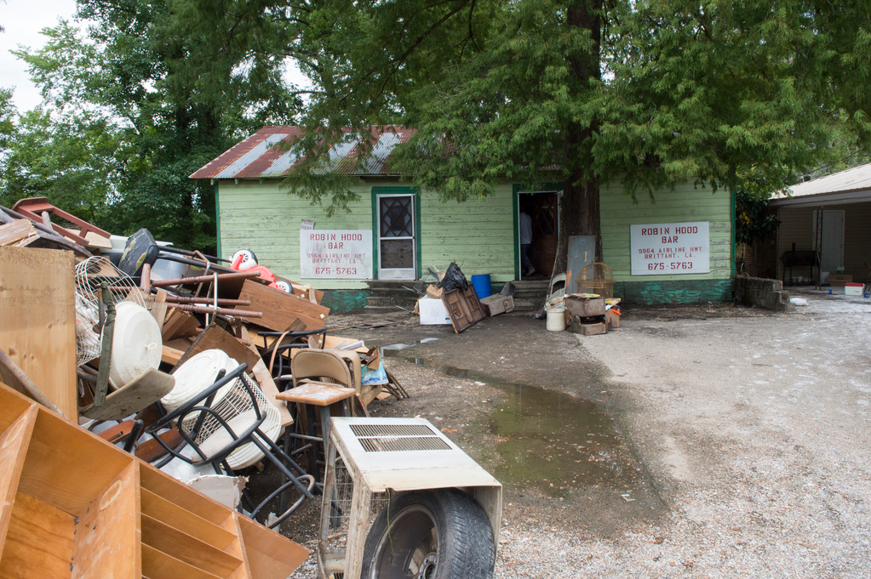
Small Business? It Depends…at the Local Level
The Montgomery County (MD) Local Small Business Reserve (LSBR) program basic screening criteria include that the business:
1) has its principal place of business in the county;
2) is independently owned and operated;
3) is not a subsidiary of another business;
4) generates a significant amount of economic activity in the county; and
5) complies with state prevailing and local living wage provisions.
Business Type | Employee Limit |  | Prior 3 Years’ Average Sales
Retail | 30 | or | $5,000,000
Wholesale | 30 | or | $5,000,000
Service | 50 | or | $5,000,000
Construction | 50 | or | $14,000,00
Manufacture | 40 | or | $14,000,00
Source: Montgomery County, Maryland
FEMA Photo by J.T. Blatty

Slide 10
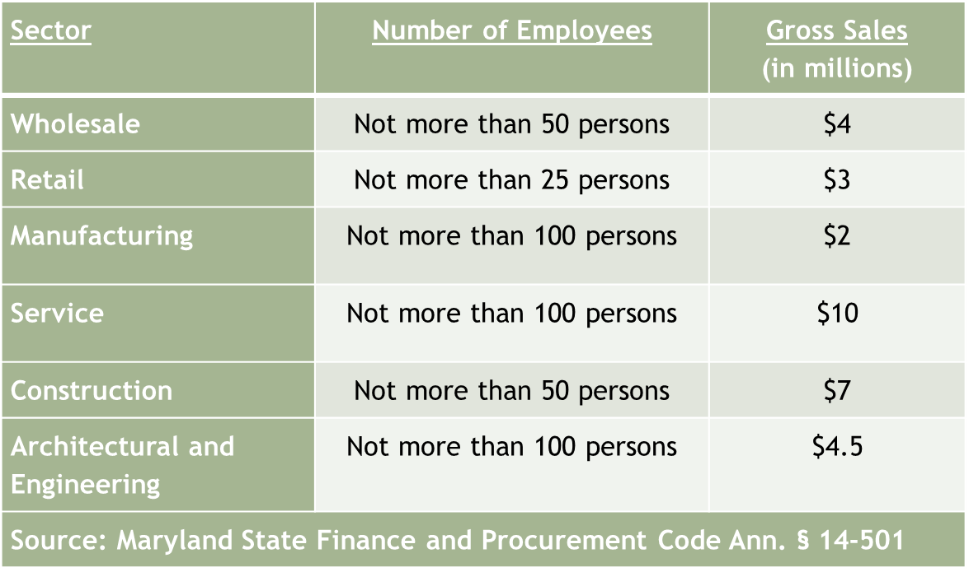
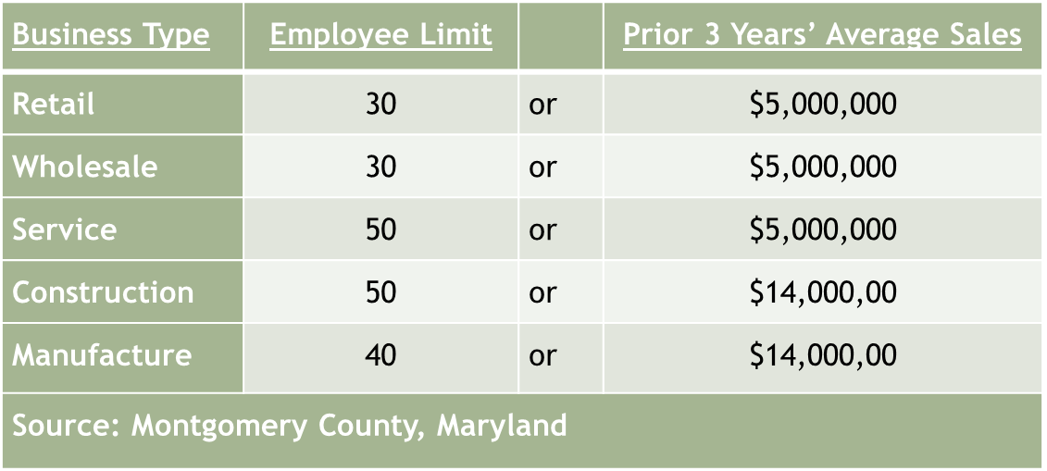
Side by Side: MD State and Local Small Business

Slide 11
Small Business and Disaster: What is a Disaster?
Two volumes…and your guess is as good as mine?

Slide 12
Defining Small Business in Disaster Research
Definitions of Small Business in Emergency Management Research
Definition | Study
500 or less employees | Haynes, Danes, & Stafford, 2011; McDonald, Florax & Marshall, 2014
200 or less employees | Schrank et al, 2013; Marshall et al., 2015
Less than 100 employees | Alesch et al., 2001; Yoshida & Dele, 2003; Flynn, 2003; Runyan, 2006; Howe, 2011
Less than 50 employees | Corey & Deitch, 2011
Less than 20 employees | Dahlhamer & D’Souza, 1995; Tierney et al., 1996; Dahlhamer & D’Souza, 1997; Tierney, 1997; Dahlhamer & Tierney, 1998
19 or less employees | Sadiq, 2011
15 or less employees | Drabek, 1991
10 or less employees | Landahl, 2013
5 or less employees | Chang & Falit-Baiamonte, 2002
Mostly an Issue of
Analytical Convenience

Slide 13
One Dimension: Operationalizing Recovery
Researchers generally conceptualize and measure disaster recovery as self-reported perceptions of business owners (Dahlhamer & Tierney, 1996; Webb, Tierney, & Dahlhamer 2000; Webb, Tierney, & Dahlhamer 2000; 2002).
Examples:
Dependent variable: Index of four self-reported items; number of employees, number of customers or client served, business profits, and whether the business was “worse off, about the same, or better off” following the disaster (Webb et al., 2002).
Dependent variable: Dahlhamer & Tierney (1996) measured business recovery based on self-reporting by businesses across a trichotomous dependent variable. Businesses self-reported they were “worse off, about the same, or better off” following the disaster

Slide 14
One Dimension: Small Business and Recovery
Factors Associated with Business Recovery
Factor | Source
Business Size | Kroll et al., 1991; Tierney, 1997; Chang & Falit-Baiamonte, 2002; Zolin & Kropp, 2007; Zhang et al., 2009
Impact on Customers | Tierney, 1997; Alesch et al., 2001; Zhang et al., 2009; Deitch & Corey, 2011; Corey & Deitch, 2011
Product Competition | Alesch et al., 2001; Runyan, 2006; Chang, 2010
Stability Prior to Disaster | Durkin, 1984; Alesch et al. , 2001; Webb et al., 2002
Entrepreneurial Skill | Alesch et al., 2001; Zolin & Kropp, 2009
Building Damage | Durkin, 1984; Alesch et al., 2001; Webb et al., 2002; Corey & Deitch, 2011
Business Sector | Kroll et al., 1991; Losocco & Robinson, 1991; Dahlhamer & D’Souza, 1997; Dahlhamer & Tierney, 1998; Tierney, 1998; Webb et al., 2002; Chang & Falit-Baiamonte, 2002; Runyan, 2006; Corey & Deitch, 2011; Marshall et al., 2015
Lifeline Services | Rose et al., 1987; Kroll et al., 1991; Tierney et al., 1996; Tierney, 1997; Webb et al., 2000; Runyan, 2006; Corey & Deitch, 2011; Asgary et al., 2012
Impact on Employees (Labor Shortage) | Tierney 1997; Dahlhamer, 1998; Zolin & Kropp, 2007; Zhang et al., 2009; Corey & Deitch, 2011; Deitch & Corey, 2011
Larger Economic Trends | Tierney 1997; Dahlhamer 1998; Webb et al. 2000; Webb et al. 2002; Chang, 2010; Deitch & Corey 2011
Female Ownership | Tiggues & Green, 1994 (-); Danes et al., 2009(+); Haynes et al., 2011(+); McDonald et al., 2014 (-),Marshall et al., 2015 (-)
Primary Market | Dahlhamer & Tierney, 1998; Webb et al., 2002; Zhang et al., 2009
Disruption of Operations | Durkin, 1984; Tierney, 1997; Webb et al., 2002; Corey & Deitch, 2011
Preparedness | Dahlhamer & D’Souza, 1997; Chang & Filat-Baiamonte, 2002; Runyan, 2006

Slide 15
Implications for Research
The review shows issues in defining business characteristics, such as the many meanings of “small business.”
The unmet research goal is to determine if any of this matters, and particularly at what business size do differentiations occur?
As the review shows, we take the ill-defined term of small business and marry it with the as ill-defined term disaster.
These issues hamper the spiral development of knowledge about businesses in disaster.

Slide 16
Implications for Policy and Practice
Small businesses are disproportionately vulnerable and face disproportionate impacts from disaster.
Local emergency planners must recognize the importance of lifeline services such as power, water, and transportation, to ensure the needs of business are considered in planning.
Emergency managers need to help small business owners foster an understanding of the community risk profile in order to recover more quickly.
Continuous and targeted outreach efforts by local emergency management agencies are critically important. The research findings show that small businesses of certain sectors are less likely to engage preparedness and mitigation measures.

Slide 17
Implications for Policy and Practice
Finally, emergency managers should, where possible, leverage public-private partnerships for preparedness (Abou-Bakr, 2013).
Existing organization and social networks provide a mechanism for reaching businesses (Landahl, 2013).
Engagement and partnerships with community business organizations such as chamber of commerce and other economic partnership groups (i.e. downtown partnerships) provide a vehicle for access to businesses to carry preparedness and mitigation messages forward (Yoshida & Deyle, 2005; Abou-Bakr, 2013).

Slide 18
Landahl, M. R., and Neaves, T. T. (2016). “Small Businesses as a Vulnerable Population.” In The Future of Disaster Management in the U.S.: Rethinking Legislation, Policy, and Finance, edited by A. LePore. New York, NY: Taylor and Francis Publishing.

Slide 19
Questions and Contact Information
Lt. Mark Landahl, PhD, CEM®
Frederick County Sheriff’s Office – Maryland
mlandahl@frederickcountymd.gov
Tonya T. Neaves, PhD, MPP
Schar School of Policy and Government – George Mason University
tneaves@gmu.edu

